Slide 1
IcT (Introduction to communication and technology)
Presentation

Slide 2
Project : DICE ROLLING SIMULATOR
Presenter : Muhammad Bilal

Slide 3

Project introduction :
Q . What will this game do?
My Project is a multiplayer dice rolling game which asks two players to enter their name .
Then it asks them to enter their desired number between 1-6 (as a dice contain 6 sides).
This Photo by Unknown Author is licensed under CC BY-SA-NC

Slide 4
CNTD…
After this there is another box in which we store the dare which loser have to do.
Actually this game is based on 2 players ,who roll the dice and if one’s selected number appears on dice ,then this player will be victorious and loser will have to perform the dare which will be specified earlier in the game.

Slide 5
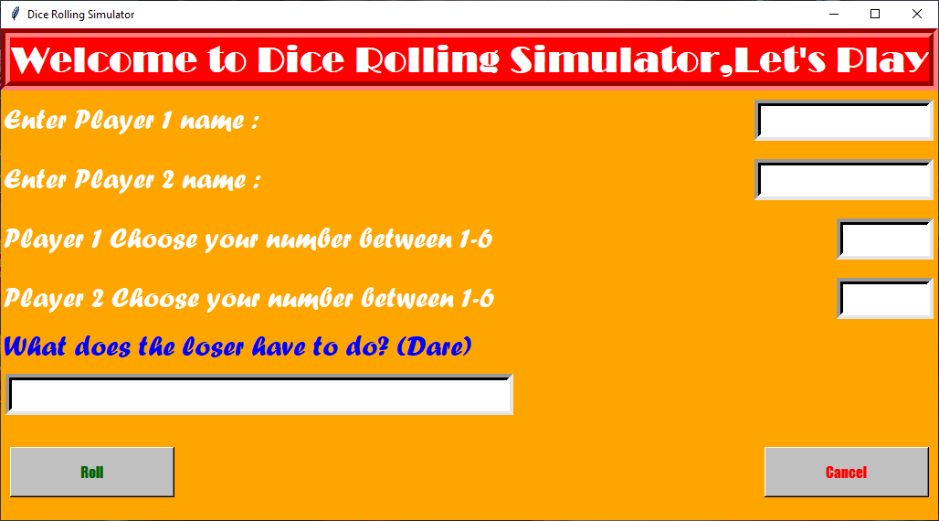
INTERFACE :

Slide 6
Libraries used :
from tkinter import *
from tkinter import messagebox
import random
.
.
.
root.mainloop()

Slide 7
Libraries used :
I used tkinter module for all the graphics used in this game, e.g. Labels, Buttons, Background Colors, Font Colors/Styles, Window Configuration etc. In general it is used to import everything that exists in tkinter module.
Q . Assuming that (from tkinter import *) means that it imports everything from the tkinter module ,so why I have used (from tkinter import messagebox) separately?
Ans . Importing “*” with tkinter does not import some packages (messagebox is one of these packages),that’s why I used it separately.

Slide 8
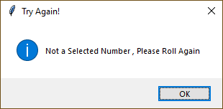
Libraries used :
I used this (from tkinter import messagebox) to show the result in a messagebox. Like :
Import random : I used random module to generate random numbers (int, float etc.) between a given range.

Slide 9
Functionality :
def Roll():
a = a1.get()
b = a2.get()
c = int(a3.get())
d = int(a4.get())
e = a5.get()
diceNumber = random.randint(1,6)

Slide 10
Functionality :
if c == diceNumber:
messagebox.showinfo("Dice Rolled",diceNumber)
messagebox.showinfo("Hoohoo!",a+" WON :-)")
messagebox.showinfo("Dare",b+" "+e)
elif d == diceNumber:
messagebox.showinfo("Dice Rolled",+diceNumber)
messagebox.showinfo("Hoohoo!",b+" WON :-)")
messagebox.showinfo("Dare",a+" "+e)
else:
messagebox.showinfo("Dice Rolled",diceNumber)
messagebox.showinfo("Try Again!","Not a Selected Number , Please Roll Again")

